Slide 1
Assessing special collections
From where we are to where we need to be
Merrilee Proffitt
Senior Program Officer, OCLC Research
@merrileeIam
25 October 2013
lauc-bconference2013

Slide 2
The Network
Changes
Everything
Notes:
The network changes everything
For the last several years, professional discourse on the future of research libraries has emphasized the increased importance and status of special collections relative to general collections. Reasons for this include the rise of the “network” and a mass migration of information seekers to large, commercial information hubs which supply large quantities of “good enough” information that is easy to find and use, and set against a backdrop of monographs digitized by a range of players, including Google, Microsoft, and the Internet Archive. In a research library setting, we’ve seen a sharp decline in use of print collections. Institutions are moving to print management involving consolidation and centralization of these collections. Going forward, we believe that the primary focus of collecting in most research libraries will centralize around rare and unique materials as well as those resources that are “distinctive to local mission and milieu.”
The early assertions about the value of special collections relative to general collections go back to 2007, and have surfaced in the report from the Library of Congress Working Group on the Future of Bibliographic Control, (published as “On the Record”) and in the 2009 Taiga Forum Provocative Statements. More recently, the group Research Libraries UK has established a work strand on “Unique and Distinctive materials” as part of their strategic plan.
However, in additions to what we read in the literature, one of the reasons that OCLC Research has invested and continues to invest in special collections is because the institutions in the OCLC Research partnership tell us that special collections represent an important challenge for them.

Slide 3
So what about special collections?
Large backlogs
Expensive processes
Increasing demand
Libraries are not shifting away from print (yet) and demand for electronic
…all against a backdrop of diminished resources
Notes:
So what are we hearing about challenges for special collections?
Our institutions are struggling with enormous backlogs – collecting has not kept pace with back room processing. This has been documented in the US and Canada both by the ARL survey that was conducted in 1998, and a survey conducted by OCLC Research 2009. Many institutions have from 1/3 to ½ of their collections in backlog, which represents a significant problem [Findings from UK Ireland survey]
There are a variety of reasons for backlogs because labor costs to process collections quite high – unlike with technical services elsewhere, there are few efficiencies to be gained with unique materials.
However, institutions have invested in getting the descriptions that they do have online, and this has resulted in increased demand for these materials. As demand for print collections has eroded, we’ve heard reports of more demand for special collections. This is difficult to document due to erratic practices in recording this data, but anecdotally, special collections staff are struggling to keep up with demand.
But it’s not as if research libraries can shift the full force of their resources and attention to special collections. We exist in a very mixed environment, where institutions are still actively collecting print while striving to move forward towards collaborative collection development and legacy print consolidation I alluded to earlier. There is a huge appetite and demand for electronic materials, and that too requires attention and management. And of course all of this is in an era of constrained resources. So what to do about special collections?
This is where archival collections assessment comes in.

Slide 4
What is collections assessment?
Systematic, purposeful gathering of information about archival collections
“Census” of collections
Can consist of both qualitative and quantitative data
Designed to help institution act strategically
Notes:
The term "archival collections assessment" is used to refer to the systematic, purposeful gathering of information about archival collections. It includes collection surveys of all kinds, including those undertaken for purposes of appraisal, setting processing and other priorities, conservation decision-making, and collection management.
An accurate census of its archival collections enables the institution to act strategically in meeting user needs, allocating available resources, and securing additional funding.
In archival collections assessment, institutions gather both quantitative data (for example, how much material is there?) and qualitative data (what is the collection about and how valuable is it from a research perspective). The qualitative data can be more difficult to gather, but this is where the real power of archival collections assessment is and where you can start to make priority calls, rather than continuing to say that all work in special collections is necessarily equal. As I’ve outlined previously, there is a crushing amount of work to be done in special collections, and being able to prioritize work is critical.

Slide 5
Why collections assessment?
Notes:
Why collections assessment? Because there’s just too much to do, too many possible directions, and you need a tool that will help to sort it out.
photo credit: http://www.flickr.com/photos/evilerin/3796279865/ Evil Erin
http://creativecommons.org/licenses/by/2.0/

Slide 6
Why collections assessment?
Too much to do, too many possible directions!
Cataloging & Processing (backlogs)
Digitization
Preservation
Collection management
However, what to tackle highly dependant on local context
Priorities shaped by resources and opportunities

Slide 7
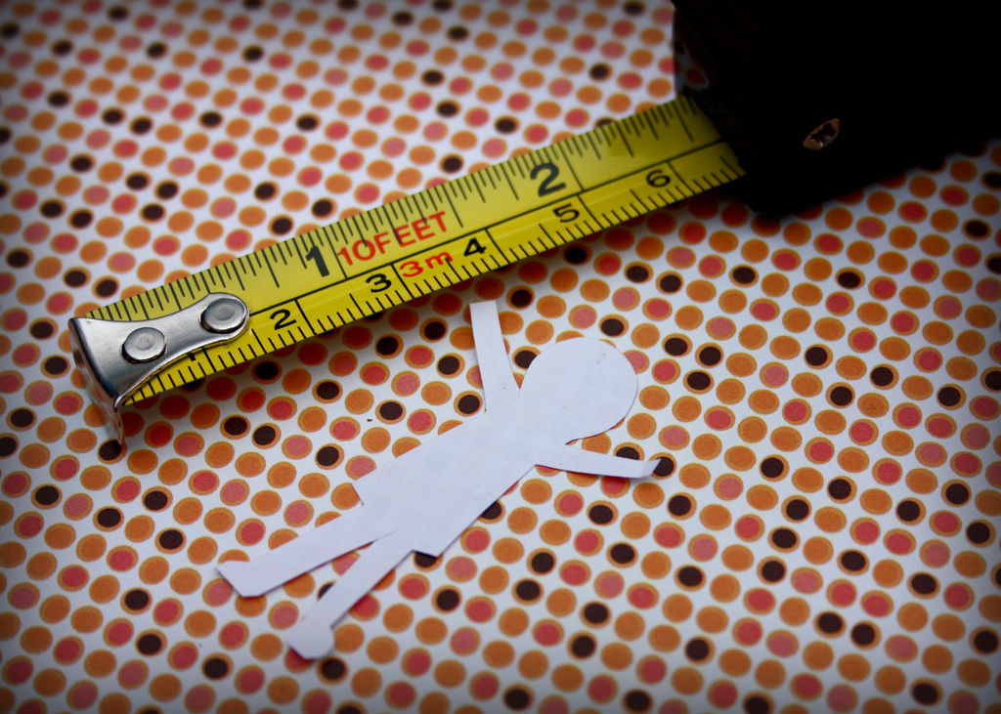
Why collections assessment?
Notes:
It’s worth remembering that we are in an era of assessment (Obviously I’m preaching to the choir here)…
Not enough to rely on good instincts any more. Assertions should be backed up with data.
photo credit: http://www.flickr.com/photos/venosdale/4376443940 Krissy.Venosdale
http://creativecommons.org/licenses/by-nc-sa/2.0/

Slide 8
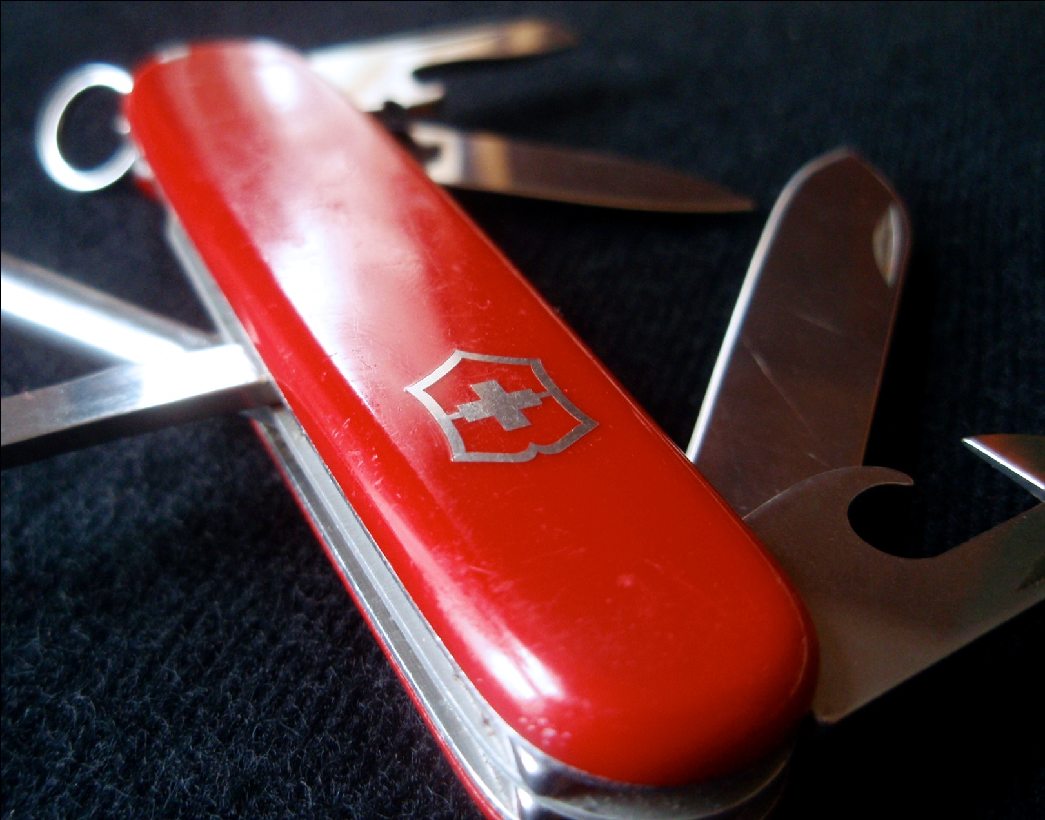
Why collections assessment?
Notes:
What you need is a Swiss Army Knife. And what we are proposing is the collections assessment is the Swiss Army Knife that you can turn to in your moments of professional need.
photo credit: http://www.flickr.com/photos/myklroventine/3474391066/ Mykl Roventine
http://creativecommons.org/licenses/by-nc-sa/2.0/

Slide 9
What we know about collections assessment
(pro tip! Google “taking stock and making hay”)
Notes:
For starters you could read our paper which is only 28 pages. (Go ahead, we’ll wait)

Slide 10
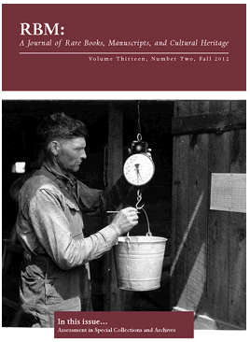
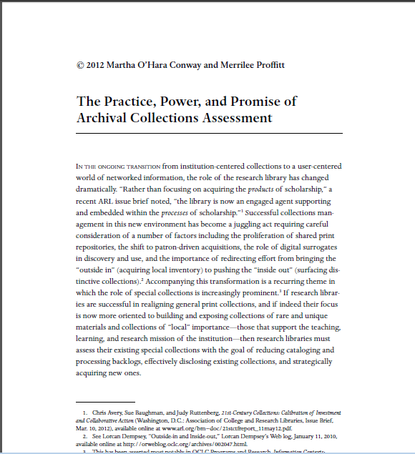
What we know about collections assessment
Notes:
I’ll take you through some of the steps involved

Slide 11
First Things First: Get Organized
Define the scope
Unprocessed collections
Collections meeting certain criteria
All collections
Identify the resources
Who will do the work?
What do they need to know?
Assemble the documentation and test the tools
Procedures manual (definitions, examples, checklists)
Paper worksheets => relational database

Slide 12
Next Things Next: Get to Work
Methodology
open the boxes
look at the stuff
Activity
count and assess the condition of the containers
identify and assess the condition of the material
evaluate arrangement (ease of use)
evaluate description (existence and accessibility)
assess research value

Slide 13
Collecting Quantitative Information
Requires little or no judgment to determine
How many? (extent)
Of what? (types of materials, special formats)
Questions
Will every box be opened, or is sampling OK?
How will extent be measured?
Which types of content will be identified?
How will it be categorized?

Slide 14
Not-So-Secret Weapon
Checklists
Types of containers
Types of materials
Collection surrogates
Conservation issues
Special formats
Topics/Themes

Slide 15
Collecting Qualitative Information
Requires making some kind of judgment in order to
assign a rating (value)
along a numeric or descriptive continuum (scale)
In a numeric continuum
1 is the lowest or worst
5 is the highest or best
In a descriptive continuum
“poor” or “terrible” to “very good” or “excellent”
“negligible” or “none” to “significant” or “very high”

Slide 16
Not-so-Secret Weapon
Ratings Descriptions
Condition
physical condition of collection material
quality of the housing in which it is contained
Physical Access (Arrangement)
Intellectual Access (Description)
Research Value
Other Value

Slide 17
What we know about collections assessment
You can do this!
There are models, techniques and tools for you to use
A growing community of institutions and practitioners
Doesn’t require special skills
Notes:
Next slide
So, some takeaways…
Institutions and tools named in the papers, but growing list – those are at this point early practitioners.

Slide 18
What we know about collections assessment
A range of institutions have used collections assessment for
Dealing with the backlog (processing, cataloging)
Prioritizing for preservation
Collection management
Making a case for funding
Notes:
Philadelphia Area Consortium of Special Collections Libraries – really a pioneer in this area, UC Berkeley
NYU, Columbia, Smithsonian Institution Archives
Univeristy of Michigan, American Heritage Center at the University of Wyoming
PACSCL
In the case of dealing with the backlogs or general collection management collections that have a low score in terms of research value may be able to use this information for deassessioning collections.
Grant funding but also could be pitching to those who hold the purse strings at your institution – can also help you find opportunities once you know where needs are.

Slide 19
What we know about collections assessment
Opportunities spaces?
Digitization and risk analysis
Assessing “born digital” needs
Collaborative uses
Notes:
PACSCL has been successful working collaboratively, as has the Black Metropolis Research Consortium.
Lack of tools has been a significant problem for collaborative work.

Slide 20
What we know about collections assessment
Foundations program: “…grants of up to $40,000 will support planning, assessment, and pilot activities that incorporate expertise from a mix of professional domains.”

Slide 21
[Thanks to Martha O’Hara Conway, Don Waters, David de Lorenzo, and Barclay Ogden]
Notes:
21
21
21

