Slide 1
UC’s Library Statistics
What is UC keeping?
(And why?)
LAUC-B Conference:
Making it Count: Opportunities and Challenges for Library Assessment
Joanne Miller
California Digital Library
Oct. 25, 2013

Slide 2
Why Systemwide?
1976…
Too many books.
Competition among campuses.

Slide 3
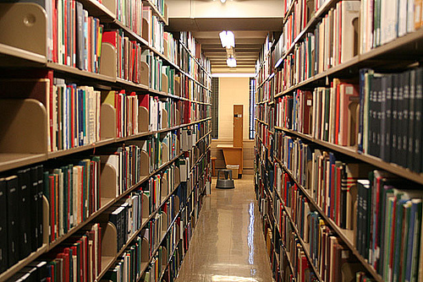

Slide 4
1977

Slide 5
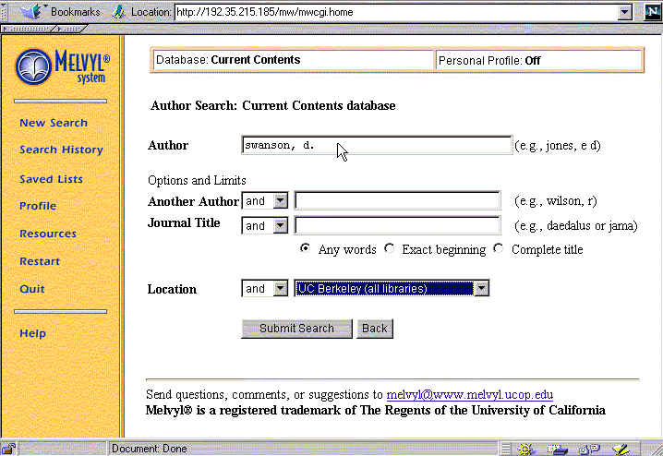
Melvyl
RLFs
Intercampus delivery buses

Slide 6
1996-1998: LPAI

Slide 7
The Seven Pillars (1998)
UC should seek innovative and cost-effective means to strengthen Resource Sharing.
UC should establish the California Digital Library.
UC should sustain and develop mechanisms to support campus Print Collections.
UC should seek mutually beneficial Collaboration with Libraries, Museums, other Universities and Industry.
UC should lead the national effort to transform the process of Scholarly and Scientific Communication.
Two more: - Information Infrastructure & - Continuous Planning and Innovation.
Notes:
Gave us the California Digital Library.

Slide 8
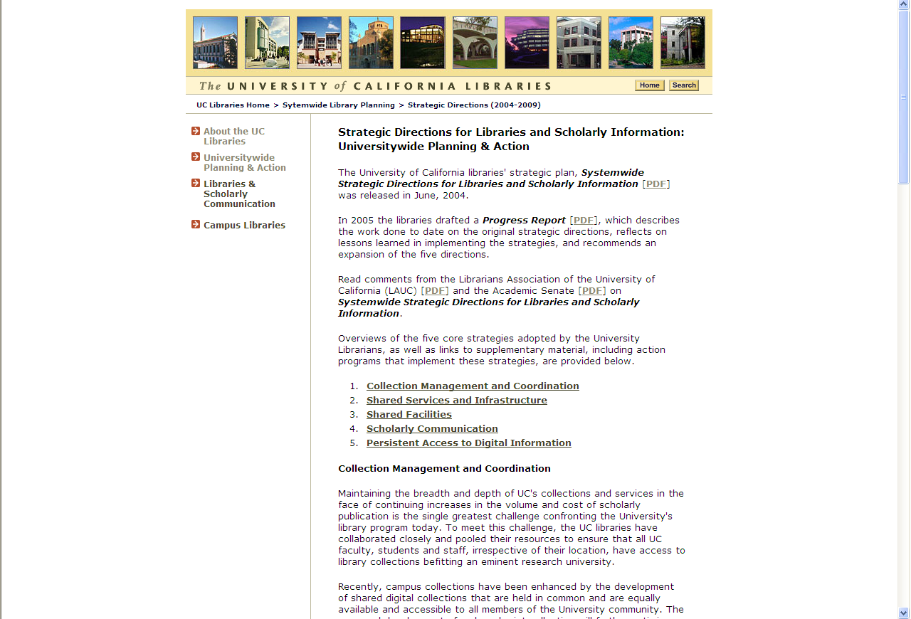
2004: Strategic Directions
Notes:
Goal: UC should seek innovative and cost-effective means to achieve comprehensive access to scholarly and scientific communication for all members of the University community.

Slide 9
The Five Strategic Directions (2004)
Collection Management and Coordination
Shared Facilities
Shared Services
Persistent Access to Digital Information
Scholarly Communication

Slide 10
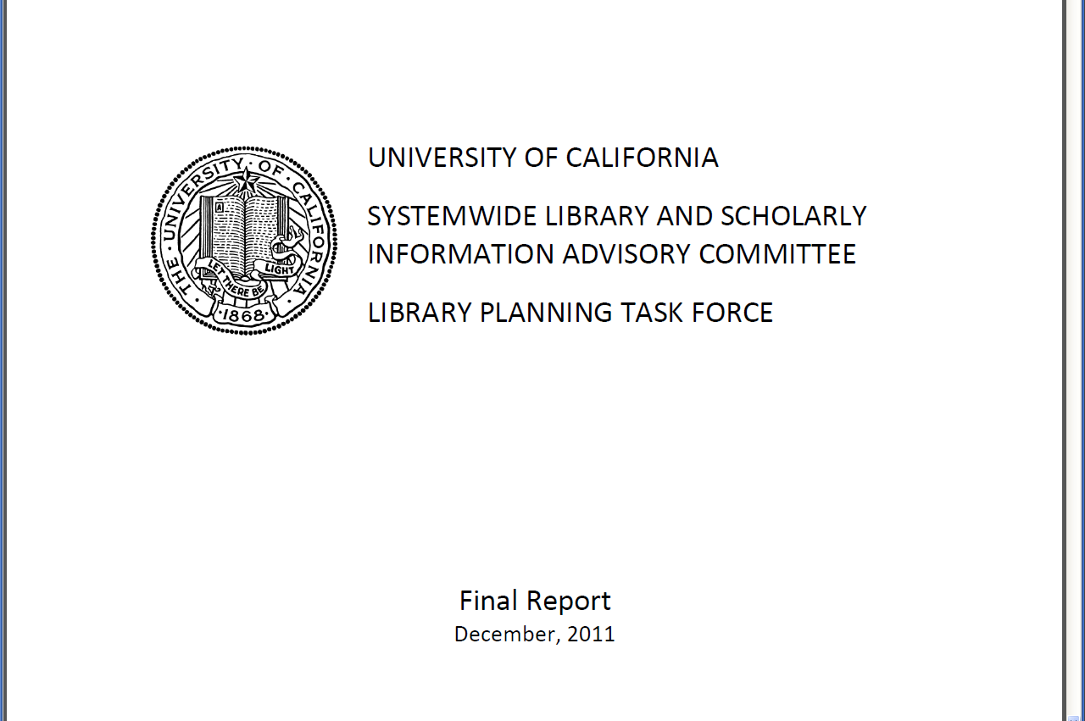
2011 SLASIAC Library Planning Task Force

Slide 11
2011 SLASIAC Library Planning Task Force
Recommendations for realizing efficiencies of $52M
Strategies for the Expansion and Management of Shared Services
Strategies that Address the Pricing of Academic Publications
Strategies to Recover Costs and Enhance and Diversify Revenue
Strategies to Improve the Framework for Planning, Consultation and Decision-Making
Notes:
NGTS, plus more.
Scholarly Communication strategies, engaging the faculty
External entities pay for services, fundraising, student fees
Established new communication channels for CoUL, EVC group, SLASIAC.
Based on this report, the SLASIAC charge was revised to give it oversight of the CDL budget and it was tasked with:
“Develop policies and strategic priorities for the California Digital Library, including policies that support the extension of CDL services beyond the University….
Review the funding models for the CDL;
• Annually review updated strategic plans, budget and operational objectives for the next fiscal
year;
• Review long‐term plans for investment and new program and service operations;

Slide 12
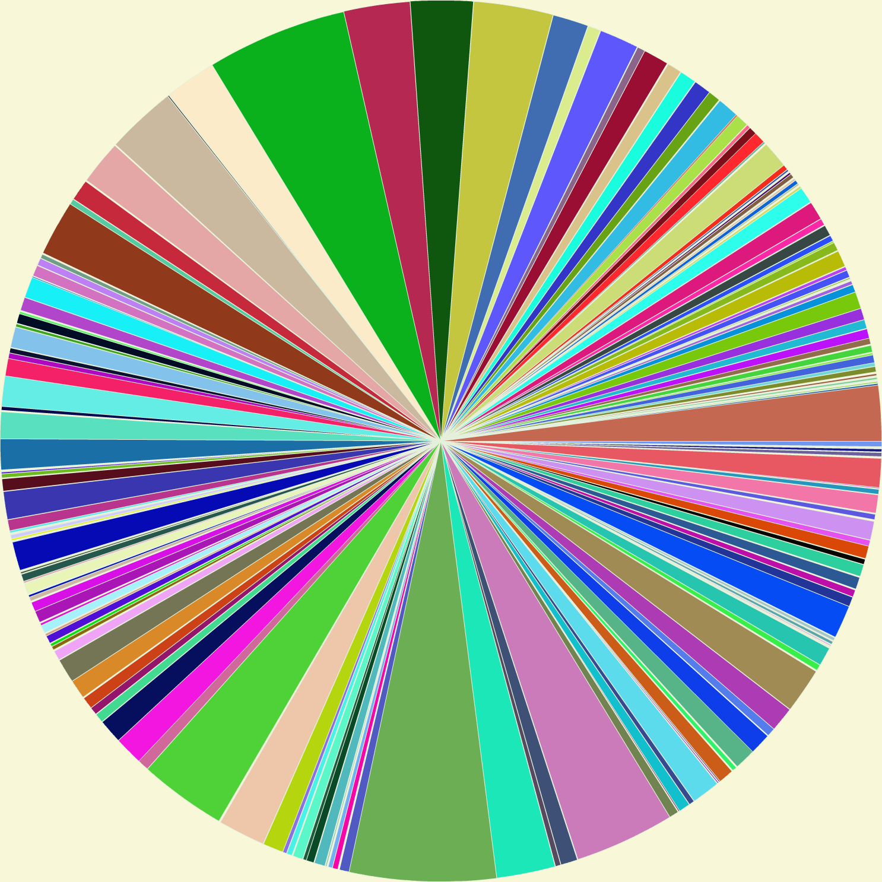
UC’s Library Statistics
HathiTrust data visualization: Library of Congress call number distribution
Notes:
[HathiTrust Library of Congress call number distribution.]

Slide 13
History
Notes:
Scanned image from 1989. Not much has changed…
Used to provide more campus detail (branch libraries), but categories of materials are same.

Slide 14
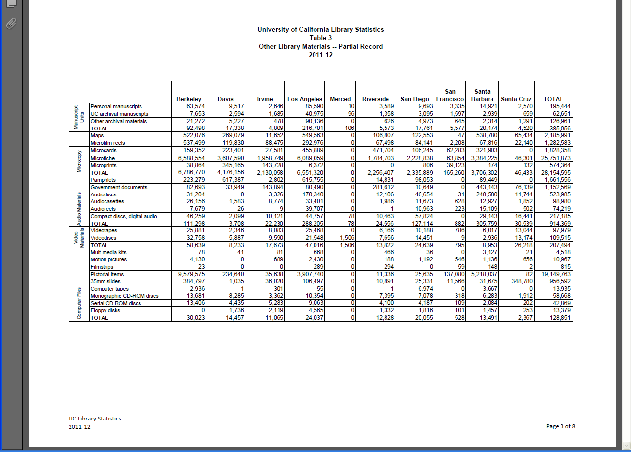

Slide 15
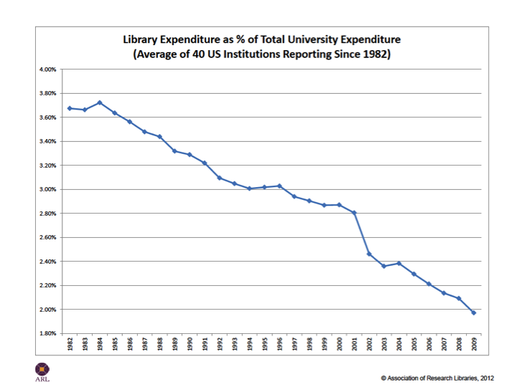
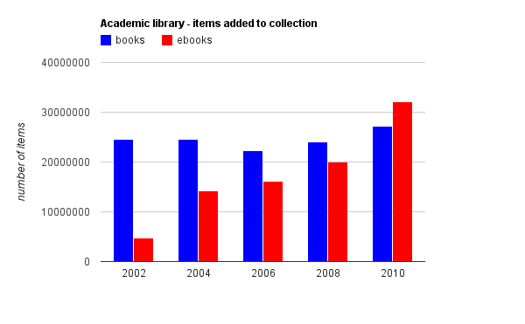
Better Display?
Graphics?
Charts?

Slide 16
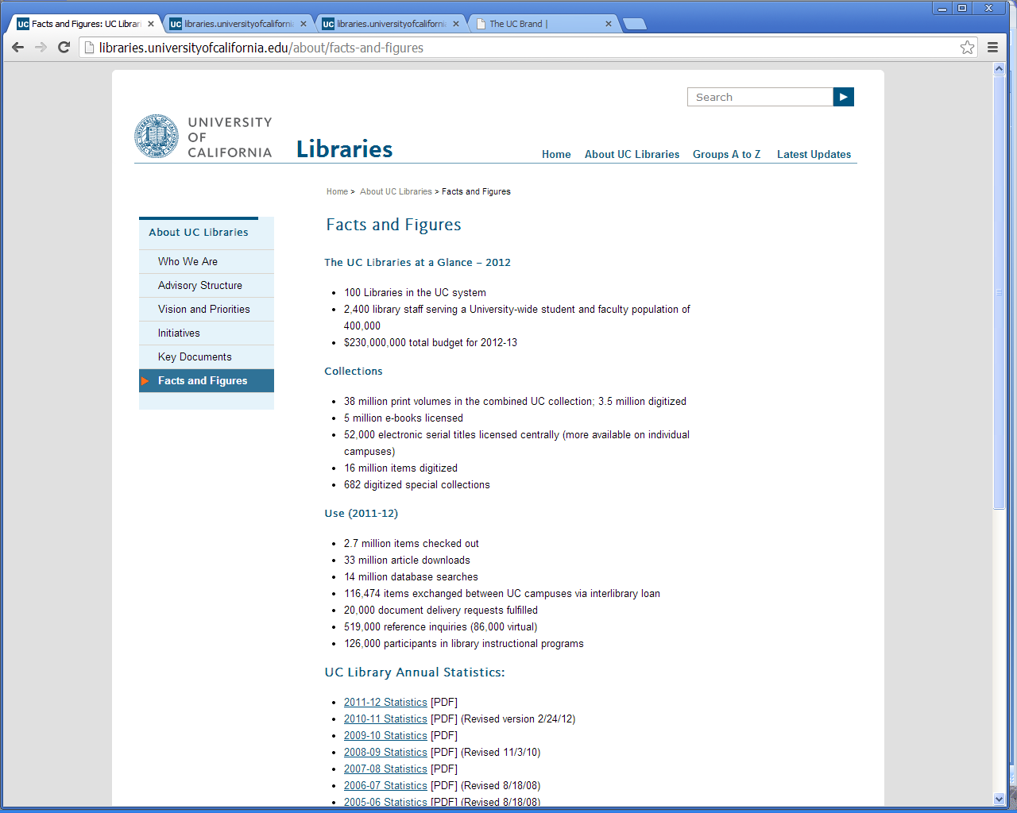
Notes:
UC Statistics since ?? At least 1984
Online from 1992 - on

Slide 17
Statistics Categories
Categories:
Volumes
Serial titles
Other library materials:
Manuscripts, maps, microfilm, microfiche, microcards, pamphlets, government docs, audiodisks, cassettes, CDs, videotapes, videodiscs, multimedia kits, filmstrips, motion pictures, 35mm slides, computer tapes, monographic CD-ROMs, serial CD-ROMs, floppy disks.
Previously: followed ARL’s lead. Align with their categories.
Additional categories from Risk Management

Slide 18
UC’s Digital Resources Statistics

Slide 19
What is ARL doing?
Manuscripts, maps
microfilm, microfiche,
microcards, pamphlets,
government docs,
audiodisks, cassettes, CDs
videotapes, videodiscs,
multimedia kits,filmstrips
motion pictures, 35mm slides
computer tapes,
monographic CD-ROMs,
serial CD-ROMs, floppy disks
Titles
Notes:
Volume count maintained for historical interest.

Slide 20
What is ARL doing?
ARL Executive Director Elliott Shore’s talk:
“The Role of the Library in the Transformative Higher Education Environment: Or Fitting Our Measures to Our Goals”

Slide 21
What is ARL doing?
Suggestions for other measures:
Cost-avoidance index?
Collaboration index?
Enterprise-fit index?
“Innovative libraries are not being rewarded for saving money, collaborating with peers, and fostering cultures that advance higher education. These qualities need to be captured somehow in the measures used to evaluate libraries.”

Slide 22
What is UC Doing?

Slide 23
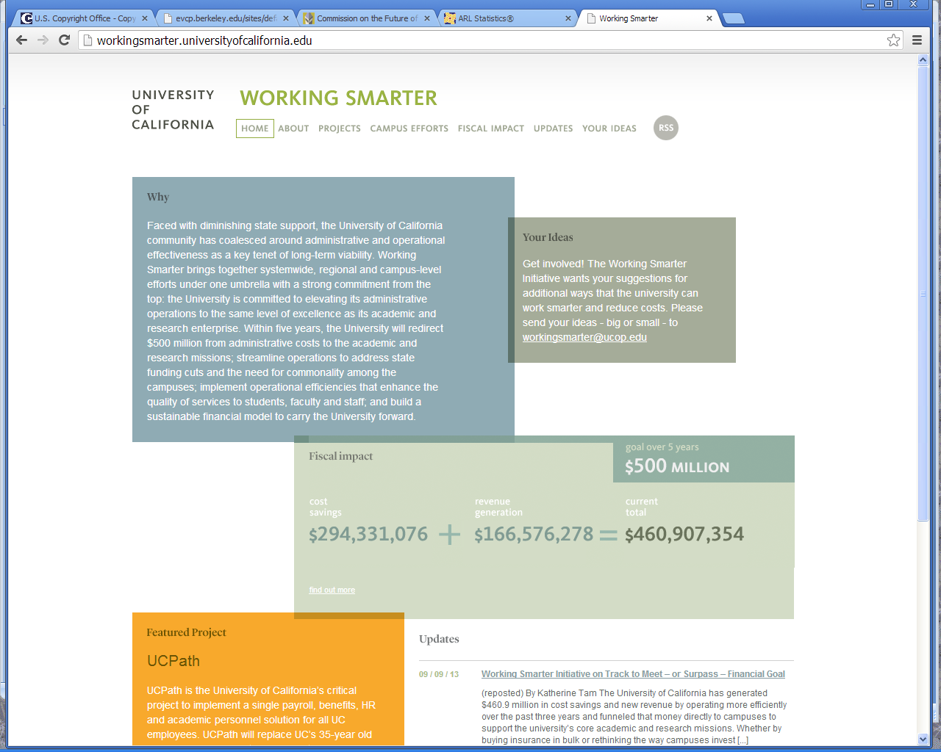
Notes:
UC libraries were included as part of the UCOP “Working Smarter” initiative in 2011.

Slide 24
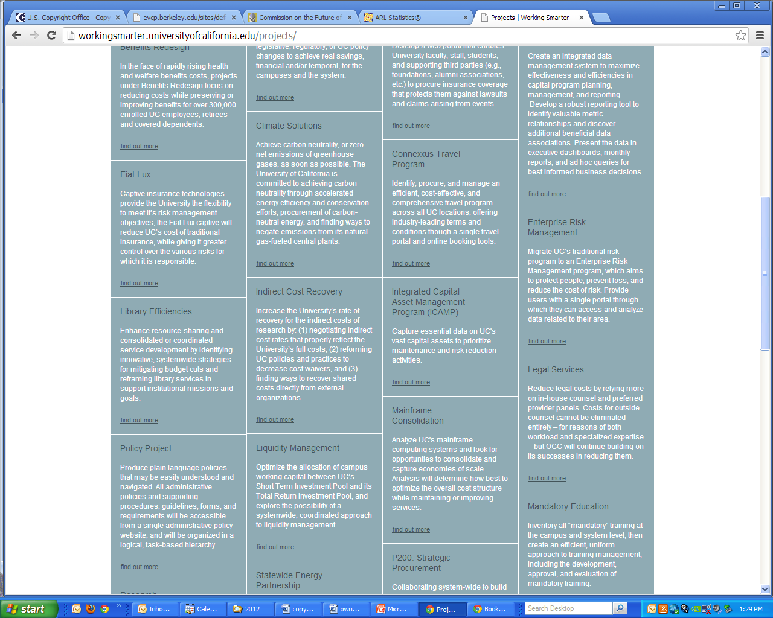
Notes:
The libraries were expected to show “efficiencies” on a systemwide basis

Slide 25
Library Efficiencies…
2011: UC libraries were included as part of the “Working Smarter”
Expected to show “efficiencies” on a systemwide basis
Many programs and initiatives in place (e.g., NGTS), but need to show progress.
CoUL survey to determine the highest priority data to collect…

Slide 26
CoUL Metrics Survey - 2012
Find measures that would be:
Readily available
Show usefulness
Demonstrate savings and/or efficiencies

Slide 27
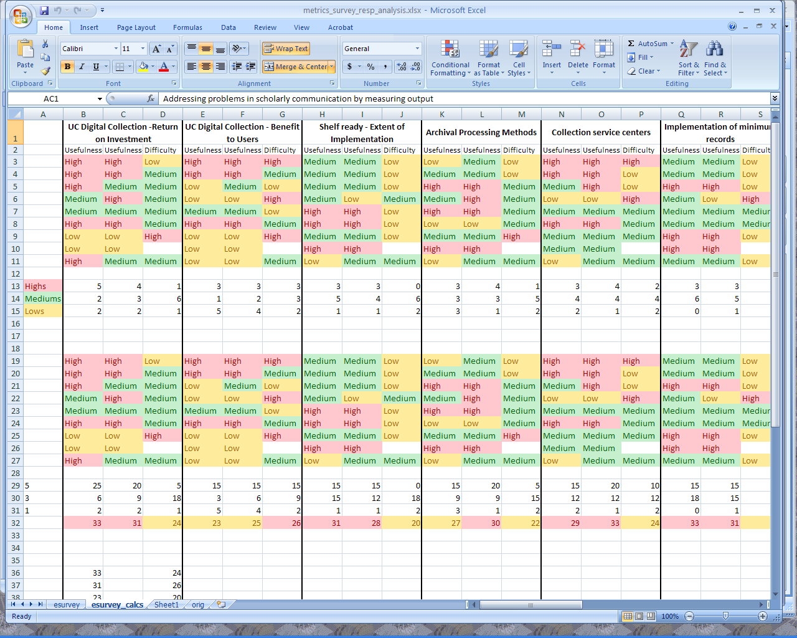

Slide 28
CoUL Metrics Survey - 2012
Results:
The number of items deselected in favor of WEST, JSTOR or RLF print issues
The return on investment for a UC Digital Collection
Outcomes of NGTS:
Collection service centers
Implementation of shelf-ready cataloging
Implementation of “minimum records standards”
Addressing scholarly communication issues and implementing successful scholarly communication initiatives.

Slide 29
UCB Report of the Commission on the Future of the UC Berkeley Library
ARL index ranking
Gate counts
Electronic access
Monographic/bound periodical check-outs
Library-sponsored instruction
User satisfaction surveys
Timeliness of delivery services
Notes:
Hard to think outside the box when you get recommendations like these….

Slide 30
Thinking about what’s next
How are the UC Statistics Used?
Annual Regents’ Budget (“Budget for Current Operations”)
Risk Management
Unit values
UC Libraries’ website
Annual price increase estimate (sent to state Department of Finance, as well as campuses)
Ad-hoc reports
Notes:
Later today, Lynn Jones & Susan Edwards: Every number tells a story: using data to make collection decisions

Slide 31
Next Steps
More interaction with campuses: Form a Statistics Common Knowledge Group (CKG).
Work with Risk Management to revise categories.
Contemplate changes to be made.

Slide 33
Any Questions?
?
?
?
?
?
?
?

