Slide 1


Library Assessment
From Measurement to Impact & Value
Steve Hiller
University of Washington Libraries
LAUC-B Conference, October 25, 2013

Slide 2
Three Library “Assessment” Questions in 1906
Is this method the best?
Is our practice adapted to secure the most effective administration?
Are we up to the standards set by similar institutions?
The success with which we answer them depends much on the success of our administration.
J.T. Gerould, 1906 (Librarian, University of Minnesota)

Slide 3
Gerould Statistics
Began in 1907, forerunner of ARL statistics
Covered volumes, volumes added, library material expenditures, total staff and staff salaries.
UCB in 1907
  173,00 volumes
  11,900 volumes added
  $17,700 materials expenditure
  15 staff
  $17,500 salaries

Slide 4
Traditional Library Measures: Inputs
Focus on how big/how much
Budget (staff, collections, operations)
Staff size
Collection size
Facilities
Other related infrastructure (hours, seats, computers)
Size of user communities and programs
Size used as excellence indicators

Slide 5
Traditional Library Measures: Outputs
Focus on usages statistics (many have declined since 1995)
Collections (print, electronic, ILL)
Reference services
Facilities, including user spaces and number of entrants
Instruction sessions
Discovery and retrieval, including Web sessions
May indicate if “inputs” are used, but doesn’t tell us what users were able to accomplish as a result.

Slide 6
Measuring Library Performance
Input and Output Statistics and Measures:
Internally focused statistical evaluation and measurement
  Cost effectiveness
  Internal efficiency
  Performance measures
  Systems performance
  Ratios
External comparisons of statistical data focused on how big and how much
Often used as surrogates for library effectiveness

Slide 7
The Challenge for Libraries
Traditional statistics/measures are no longer sufficient
  Emphasize inputs/outputs – how big and how many
  Do not tell the library’s or customers’ story
  Often not aligned with organizational goals and plans or support library strategic directions and objectives
  Do not capture the impact and value of the library
Need to demonstrate difference the library makes
  To the individual, community and the organization

Slide 8
Many Library Statistics Are Self-Reported and Lack Independent Verification

Slide 9
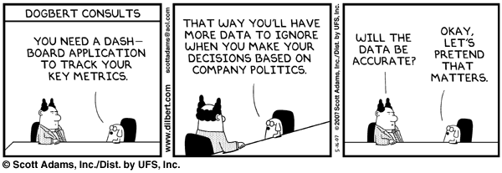
And of Questionable Accuracy

Slide 10
What Will We Measure?
What is easy to measure is not necessarily what is desirable to measure. Martha Kyrillidou
Institutional assessment efforts should not be concerned about valuing what can be measured, but instead about measuring what is valued. A. Astin
A strategy without measures is just a wish and measures that are not aligned with strategy are a waste of time Joe Matthews

Slide 11
Four Useful Assessment Assumptions
Your problem/issue is not as unique as you think
You have more data/information than you think
You need less data/information than you think
There are useful methods that are much simpler than you think
Adapted from Douglas Hubbard, “How to Measure Anything” (2010)

Slide 12
Assessing What’s Important
Contribution to student and faculty success
Contribution to institutional mission/visibility
And, perhaps (depending on library and institution type)
Accountability/Efficiency/Effectiveness
Use
Revenue generation (including fund raising)
Comparisons with others

Slide 13
Recent Trends in Library Assessment and Performance Measurement
Greater reliance on external measures and user impacts; aligned with planning
Customer-centered library concept
Outcomes-based assessment and metrics that made use of multiple methods, including qualitative
Collaboration with institutional and other partners
Demonstrating library impact and value on individuals and communities

Slide 14
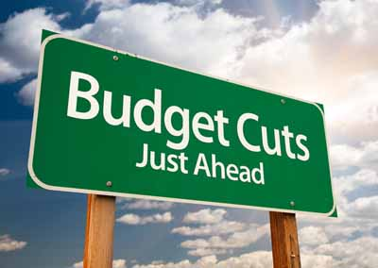
Current Assessment and Performance Drivers
Accountability, Accreditation and Affordability
Budgetary pressures
Networked environment
New tools for data capture, analysis and presentation

Slide 15
Standards Become Outcomes Based
Move from inputs to outputs, impacts and outcomes
Outcomes-based standards are moving away from prescriptive numerical (hard) measures towards more of a best practices model which offer evidence-based choices
  Higher education accreditation
  ISO 16439 (Methods and procedures for assessing the impact of libraries)
  Library associations

Slide 16
Assessment from Improvement to Advocacy
Assessment to support advocacy and strategic development plays larger role
Moving beyond satisfaction and internal performance
Using assessment data to support narratives
Developing a communications plan that identifies key points for each stakeholder group
Making the case for investment in the library

Slide 17
Case Study
University of Washington Budgets 2009-12
State funds cut by 50% ($400 million to $200 million)
Undergrad student tuition increased by 50%
  $7,000 to $10,500 annual cost
  Students pay 70% of education cost, up from 30% in 2004
External research funds rose 30% ($1.1 to $1.4 billion)
  UW ranks 2nd in U.S. federal research funding ($1+ billion)
  85% goes to Health Sciences, Science-Engineering-Environment
Libraries budget cut by 12% between 2009-11
  48 positions eliminated
  $2.4 million reduction in collections budget

Slide 18
In God We Trust:
All Others Must Bring Data
UW Libraries Assessment Program: Using Data Effectively for Improvement and Advocacy
Large scale user surveys every 3 years since 1992
In-library use surveys every 3 years beginning 2002
Focus groups/interviews
Observation (guided and non-obtrusive)
Usability/User-Centered design (including space)
Usage statistics/data mining/peer library statistics
Performance metrics
Information about assessment program available at:
http://www.lib.washington.edu/assessment

Slide 19
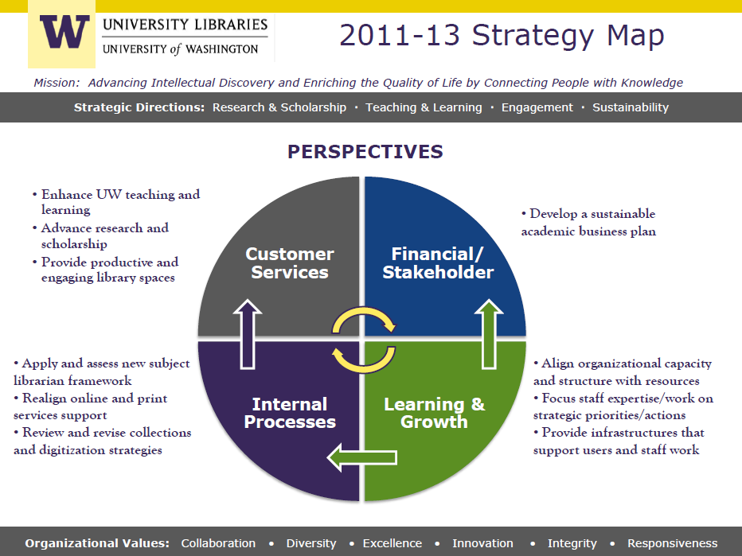
Our 2012 Budget Planning Strategy:
Selective Focus and Persuasive Data
Invest in Libraries to support faculty research and student services and maintain competitiveness
Restore collections funding
Maintain hours of opening/access to libraries
Maintain student jobs in libraries
Invest in renovation of key libraries
Support core and emerging services
Enhance multi-institutional collaboration for efficiency and effectiveness
Notes:
Enhance teaching and learning
Advance research and scholarship
Provide virtual and public spaces that engage, connect and transform our communities
Build a sustainable information infrastructure that preserves and advances knowledge

Slide 22
ARL Salary Rankings: U.S Libraries
 | UW Average | UW Rank ARL U.S. Libraries (n=100) | UW Median | UW Rank ARL U.S. Libraries
2008-09 | $66,517 | 50 | $60,312 | 54
2009-10 | $66,476 | 51 | $59,934 | 56
2010-11 | $65,466 | 54 | $58,752 | 67
2011-12 | $64,992 | 64 | $58,704 | 74
2012-13 | $64,290 | 69 | $58,428 | 79

Slide 23
UW Libraries Funding Changes FY11 to FY14
Focus on students and research support
FY 11 | 5% reduction Provost investment Realized cut | -1.35 million 1.00 million* -.35 million *Largest of any admin unit
FY 12 | Collections funding (temporary) Hours of opening Student hourly jobs Undergraduate library renovation | 2.00 million .25 million .25 million 16.5 million (state-funded)
FY 13 FY14 | Collections funding made permanent Libraries exempted from 2.9% campus reduction Libraries hiring plan approved (vacant librarian positions can be filled) Collections inflation funding treated as “utility” Student wage increases centrally funded | 2.0 million 0.6 million 0.1 million

Slide 24
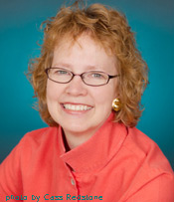
During Difficult Economic Times
Align strategy with institutional mission and priorities
Build on the library’s existing strengths
Use evidence to support your case
Enlist the support of others in the university community
Position the library as a change agent
Great universities have great libraries and UW has
a great University Librarians (thank you Betsy Wilson)

Slide 25
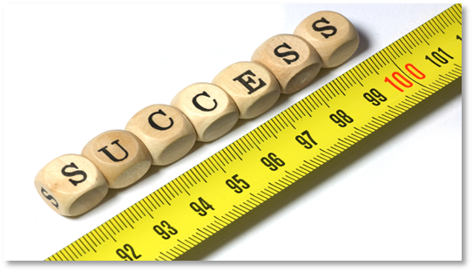
Two Major Trends Post-1990
Not how good is this library? Rather, 'How much good does it do?' (Orr, 1973)
I. Customer-centered library
All services and activities are viewed through the eyes of the customers
Customers determine quality
Library services/resources add value to the customer
Focus on users has led to outcomes-based metrics

Slide 26
“Library” Users in the Networked World
(Dempsey et al 2007)
Personal search replaces ‘ask a librarian’
Global search of the global library
  If there’s no response in 3 seconds, try elsewhere
    Then: Resources scarce, attention abundant
    Now: Attention scarce, resources abundant
Social networking/communication - wikis, blogs
Where’s the text? Discovery to Delivery is one action.
Satisficing
  Then: what is the best source of authoritative information?
  Now: which is the most readily accessible source of adequate information?
Network tools used are embedded in workflow

Slide 27
Understanding Communities is Critical
Our communities need library services and collections which are embedded in their:
  Workflows, Learnflows, Leisureflows, and Lifeflows
Engage with their languages and their processes of learning, research, leisure and … life
Learn what’s important to them
  Because they may not come to us
  They do have other choices
Support learning, research and life where they occur –

Slide 28

Two Major Trends, post-1990
II. Collaborative assessment:
Collaboration with other institutional programs/units
Collaboration with other libraries/consortia organizations
Linked to strategic planning, accountability, advocacy
Standardized definitions & user-centered tools that can be used across libraries
Fostering assessment & performance measurement community through conferences, etc.

Slide 29
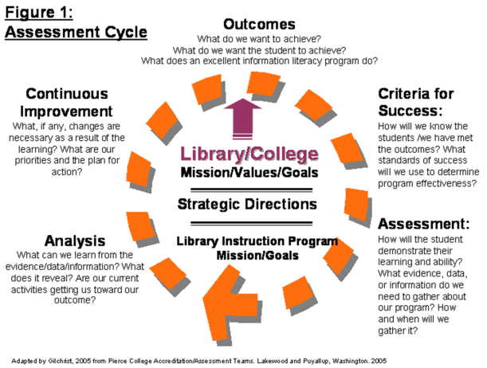
From Bibliographic Instruction to Teaching & Learning
Bibliographic Instruction:
  Library focus
  Evaluation by pre- and post-tests
ACRL Task Force on Academic Library Outcomes (1998)
ACRL Information Literacy Competency Standards for Higher Education (2000)
Teaching & Learning
  Focus on student learning outcomes and authentic assessment
  Partnerships & contribution to course/program outcomes

Slide 30
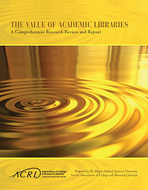
Library Value & Impact
Value of Academic Libraries (Oakleaf, 2010)
Lib-Value Project (ARL, Tennessee)
Library Impact Data Project (Huddersfield/JISC)
Methods and procedures for assessing the impact of libraries (ISO 16439)
Discovering the Impact of Library Use and Student Performance (Wollongong)
ACRL Assessment-in-Action project
University of Minnesota Library Data & Student Success

Slide 31
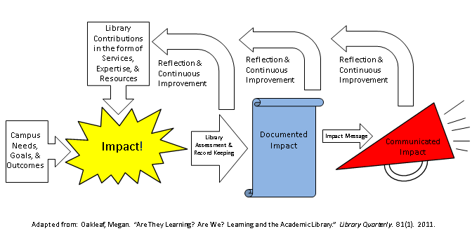
Value & Impact: Key Themes
Connecting institutional & library data
Aligning library’s role with core mission & values of institution: “allow institutional missions to guide library assessment” (Oakleaf 2010, p, 30).
Communicating value to stakeholders

Slide 32
Research Support
Traditionally, collections most valued library support
  Journal collections
  Monographs, media, special collections
Surfacing special and unique collections
Support information management such as research data management, data curation, and citation analysis
Scholarly communication has become part of research support
Collaborate with campus partners (e.g. Office of Research)

Slide 33
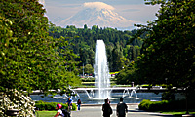
Building the Assessment Community
2014 Library Assessment Conference
Seattle, August 4-6
Workshops on August 3, 7
Call for proposals within next few weeks
  Expanded presentation formats from previous conferences to include panels and lightening round talks
Proposals due by mid-January
Proposal submitters notified in March
Conference registration opens April
550 to 600 registrants expected

Slide 34
Lorcan Dempsey’s 3 Challenges (2013)
Engagement
  Libraries work to create distinctive value in the research, learning and teaching workflows of their users in ways which go beyond the provision of collections
Rightscaling
  Libraries moving from “institution scale” to collaborative, shared systems – especially through functional and regional consortia. The need for local infrastructure declines.
Institutional innovation
  Library as organization which reconfigures to map changes in the user environment and expectations
  The learning that flows from institutional innovation

Slide 35
2013: Four Library Assessment Questions
What do we need to know about our communities and customers to make them successful?
Who are our partners in collaborative assessment?
How do we measure the effectiveness of our services, programs and resources and how they contribute to user success.
What do our stakeholders need to know in order to provide the resources needed for a successful library?

