Slide 1
Small Data Assessment and Action Research
April Cunningham, Palomar College
Stephanie Rosenblatt, Cerritos College
Making it Count: Opportunities and Challenges for Library Assessment
lauc-b 2013, Berkeley
Notes:
Intro of presenters/pre conf/ (SRR, 5 mins)

Slide 2
Learning Outcomes
Learning Outcomes
I. Articulate questions about your practice and collaborate with peers to generate ideas for investigating these questions
II. Practice using various methods and tools for data collection and analysis.
III. Understand the concept of action research
Notes:
Intro:
During today’s workshop, it’s our hope that you will leave with a greater understanding of the AR methodology, learn habits of mind that can help you conduct your own research, gain experience with some new methods of data analysis, and develop a plan for a project you can begin when you return to your institutions. That’s a lot to accomplish in just three hours, so we will keep you moving. Just a few notes: you’ll be working in groups and you may end up working on scenarios or problems that fall out of your area of interest. It’s our belief that what you’ll learn here will be transferrable to any mileu. I also want to remind you that learning is uncomfortable, you may sometimes feel a little frustrated, but we’re here to make sure we can channel that energy productively. Also, you won’t need to use your laptops until after our break, which will be at around 2:30, so please leave them turned off if you need to conserve power. You’ll also see power strips around the room if you need to plug your laptop in for a charge. We’ve put all of our conference materials up on a blog which we will access after the break, but we’ve provided a handout with a rough outline of the presentation so you can take notes. However, the powerpoints, all of our scenarios, lists of tools, etc. are all up on the blog, so don’t worry about writing it all down. So, let’s begin.

Slide 3
Action Research Cycle
Plan
Act
Reflect
Share
Notes:
What is action research?
Ask for input.
Action research is research done by the practitioner, in our case the librarian. The researcher is started in response to a problem the librarian has identified in her own work. The goal of the research is for the librarian to learn some more about what's going on so improvements can be made. Something will change as the result of this work. It doesn’t happen to just describe what’s going on, you might end up doing that but the reason you’re trying to describe something is because it doesn’t seem right or you need to understand it more so improvements can be made.
Action research isn't a solitary venture. It's collaborative. The librarian talks to other people about what she's doing, what's bothering her, what she's trying to find out. She may develop her research interests in conversation with others and they may conduct the research together -- or they may serve as a group of critical friends. The librarian keeps going back to these people to bounce ideas off them: data she'll collect, ways to analyze it, what she's discovering.
Throughout the process and through these conversations, the librarian reflects on what she's doing and learning. She thinks about how what she's discovering supports or contradicts common knowledge. She shares these realizations with others.
In the end, some kind of change happens: things are done differently or understood differently and that change will probably go beyond that individual librarian whether or not this new knowledge is disseminated formally.
The reason I find this methodology to be so powerful for librarians is that it empowers the researcher by valuing the expertise of the practitioner, or the person actually doing the work.
History of action research
Action research was first described or named Kurt Lewin, a psychologist, in the 1940s. (Although the process employed was used prior to this time." It was a methodology adopted by a number of fields, including education, because it was believed as Lewin stated, "in order to change certain social practices, social scientists have to include practitioners from the real world in all phases of inquiry." It's practice supported John Dewey's ideas about reflective teaching.
But by the end of the 1950s there was an increase in professional researchers in education so this methodology fell out of popularity until the 70s were when it was referred to as a the teacher researcher movement.
Let me try to explain how this research method was so revolutionary for teachers because it will help you understand why I think it can benefit librarianship. If you think about it, the majority of the time teachers are either the subject of a research study or technicians who are asked to implement a program or curriculum correctly so that the impact on student learning can be measured by outside experts. In action research the teacher is the researcher instead of the subject.
Many parallels can be drawn between the nature of teachers work and librarian's work.
Teachers, like librarians, are usually autonomous agents. However, they work within bureaucratic systems and are subject to various dictates that are beyond their control. They are expected to act as experts and professionals, to be masters of all of their job duties. Admitting you have a problem is to admit that you are unable to perform your job. Action research presents a way in way which teachers or librarians can address their difficulties as competent professionals while leveraging their expert knowledge in order to serve their clients better and to improve their profession. This can be done within existing constraints, as you'll soon see, but because it's collaborative, it also offers a way for practitioners to completely alter the system from the bottom up.
Action research cycle
let's take a moment to look at the action research cycle. For one, it's a cycle which means it never ends. Today we're going to try to go through a complete cycle in what I call Julia Child fashion, meaning some of the time you'll start with raw ingredients but some of the time you'll work with an already baked cake that you can just frost. You’ll learn more about each stage of the process when we present examples or when you get to practice SOMETHING through some guided exercises.

Slide 4
Types of Action Research
Notes:
Three types

Slide 5
Action Research is…
Informed by concerns about practice/praxis
Conducted and often initiated by the librarian(s)
impacted as their expertise is valued
Collaborative
Critical, deliberative, and self-reflexive
Instigated with the goal of changing practices, processes, policies, theories, or systems
Applicable to the local context
Notes:
Action research is research done by the practitioner in order to improve his/her working conditions or efficacy. The purpose of the research is to solve a problem the worker/practitioner is having or to investigate a phenomena he/she has noticed in the course of his/her working life. The initial research question may be developed by the researcher alone or may come out of conversations or gripes with his/her colleagues. The researcher talks about the problem with colleagues or “critical” friends in order to hone his/her question and to develop a methodology to investigate it. The researcher shares news about his/her progress in collecting and analyzing data with the same group of interested people in order to get input from people outside of the data collection/analysis process who are familiar with the problem being investigated by the researcher. The researcher shares what he/she has learned with the same group of people and perhaps a wider audience formally or informally. The goals of action research are the empower the practitioner as he/she should be regarded as an expert in his/her work and the process of conducting research can also improve the researcher affect in terms of valuing his/her own expertise. It is also a way create or improve “best practices” and to challenge commonly held “truths” that have been unsubstantiated.

Slide 6
Planning to Plan
Check to see if Action Research is really what you want to do (maybe a less critical form of practitioner research would be better)
Is one of your goals to find out if the consequences of your actions measure up to the professional principles and values that motivate your work?
Notes:
If you decide that a less critical approach to practitioner research will be most appropriate for you, many of the techniques and tools we’re going to talk about will still be useful.
You have many goals for this inquiry.
This is what makes action research more than just a needs assessment for a program improvement plan.

Slide 7
Task: Clarifying Your Question
Take a moment to think about your own work. What’s problematic?
Generate one or two questions you’d like to investigate.
Talk to a partner in your group. Do you share any questions/problems in common?
Notes:
You suspect that students who learn about research sources from you in a library orientation will have a wider range of source-types in their papers. You care about this because you assume that a wide range of appropriate sources will lead to deeper learning and better analysis
Preliminary Question: What’s the difference in the types of sources students are using when they come to one of my library orientations and when they don’t?
Share Questions/Problems generated from Group

Slide 8
Animating Your Plan
What is the situation right now? How can I find out?
This is the reconnaissance phase.
You will identify your key issues
Make some notes about Data on page 2 of your handout.
Notes:
For the problem or question you just identified, start thinking about the data you already have or the data you could collect easily. This will let you answer the question: what is the situation right now?
Example:
Find ways to observe students’ use of sources in their papers. Bibliographies? Entire papers? Faculty surveys? Electronic portfolios? Theses or Dissertations? Student focus groups?
Analyze this initial evidence to identify key issues. Students source types don’t vary depending on the instruction they received. But, overall, students aren’t incorporating sources well.
These key issues might lead you to review the existing literature. Notice that the key issues come from your initial analysis, not from your common sense, your expertise, your discussion with superiors, or accountability standards.
We’ll talk about sharing results later, but these key issues should also get you started thinking about who would be your audience for any knowledge you create from your inquiry. Who else is interested in the issues you’ve noticed? What types of data will be meaningful not just to you but also to the other people who are interested in these issues?

Slide 9
Decide How You’ll Do These Things
Keep a journal or other form of notes
This helps you see where you’ve been
This gives you a place to recognize and set aside your assumptions
Keep big questions in mind even while you’re working from day-to-day
Cope with inevitable interruptions and competing priorities
Identify sources of help with data analysis
Find critical friends

Slide 10
ACT
Collect data
Analyze data
Continue to talk to collaborators or friends about your findings to get different perspectives on your process/methods and what you’re discovering

Slide 11
Act
Action Steps… What changes can I make?
Your analysis of the initial evidence has helped you identify key issues. Now what can you do about them?
Notes:
Create an action plan that you’ll implement over a period of time and collect more evidence. You conduct a professional development session for faculty about helping students incorporate sources into their papers. You shift your instruction focus from finding sources to reading with purpose.

Slide 12
Data Collection Tools:
Notes:
Demo various tools depending on the datasets we choose. (4 mins each, 20 mins)
Google forms
Survey monkey
LibStats
LibraryHelp
Milennium or the backend of cir software
Vendor records for database hits
ILL systems
Surveys, checklists, students

Slide 13
Data Analysis Tools:
Google Forms
Tableau Public
Excel
Rubrics
LIWC
Word
text.stat
Notes:
Demo various tools depending on the datasets we choose. (4 mins each, 20 mins)
Many Eyes (quantitative, VA)
* Excel (quantitative, SSR)
* LIWC (qualitative, April)
* Tag Crowd (qualitative, VA)
* Word (qualitative, April)
* text.stat (qualitiative? SRR)

Slide 14
Google Forms

Slide 15
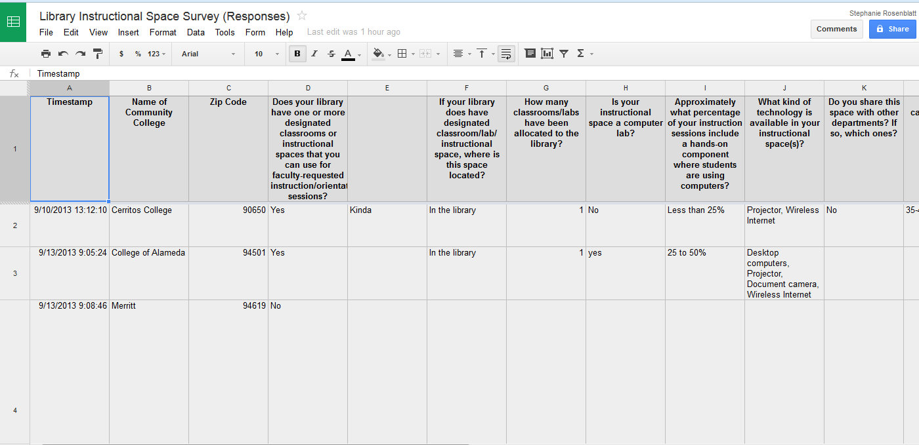

Slide 16
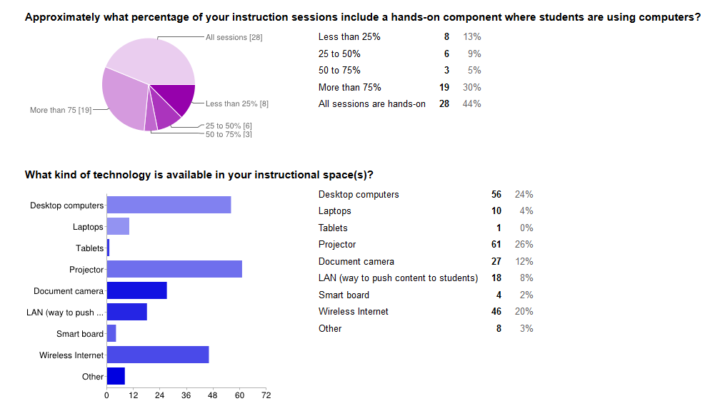
https://docs.google.com/forms/d/1QYYKMCZUn-BM2qvPGaT6TsZx4jLwf9-neW0pA0bADoo/viewanalytics

Slide 17
Tableau Public

Slide 18
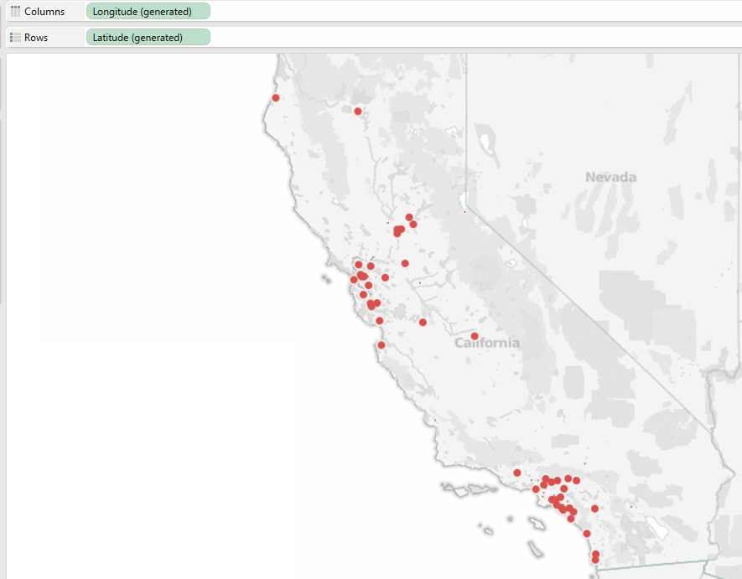

Slide 19
Microsoft Excel
Notes:
Review what can be done in Excel.
MS Excel is a great statistical tool – good for quantitative analysis.

Slide 20
Types of Statistics
Descriptive statistics
Inferential statistics
Describing the numerical data you have by organizing, graphing, or tabulating.
Using the sample you have to make inferences or hypotheses about a larger population.
Notes:
You can use EXCEL for descriptive and inferential statistics. DEFINE both with examples of types of tests.

Slide 21
Nominal
Ordinal
Interval
Ratio
Notes:
There are 4 levels of quantitative data: nominal, ordinal,interval, and ratio. A lot of the data we get in library instruction is nominal or ordinal, and ocassionaly interval.
Nominal – male or female – exclusive catergories that don’t have a “value”
Ordinal – likert scales, strongly agree, agree, disagree, strongly disagreee – exists in catergories that are ranked or related to each other by more/less
Interval – grades – data that is related or ranked like ordinal data, but the assumption is made that there is equal distance between the scales, but there isn’t ameaningful 0.
Ratio data – 0 is meaningful. Like no money in your pocket. HELP APRIL.
The types of tests you run on your data are determined by the type of data that you have, and how your data is distributed, and then what you want to find out.
Much of the time, we only need descriptive statistics to answer the questions we have in libraries. But, no matter what, you have to start with descriptive statistics: namely measures of central tendency (mean or average, median, mode) and find out if the data is skewed or balanced, in order to determine if you can run further tests.

Slide 22
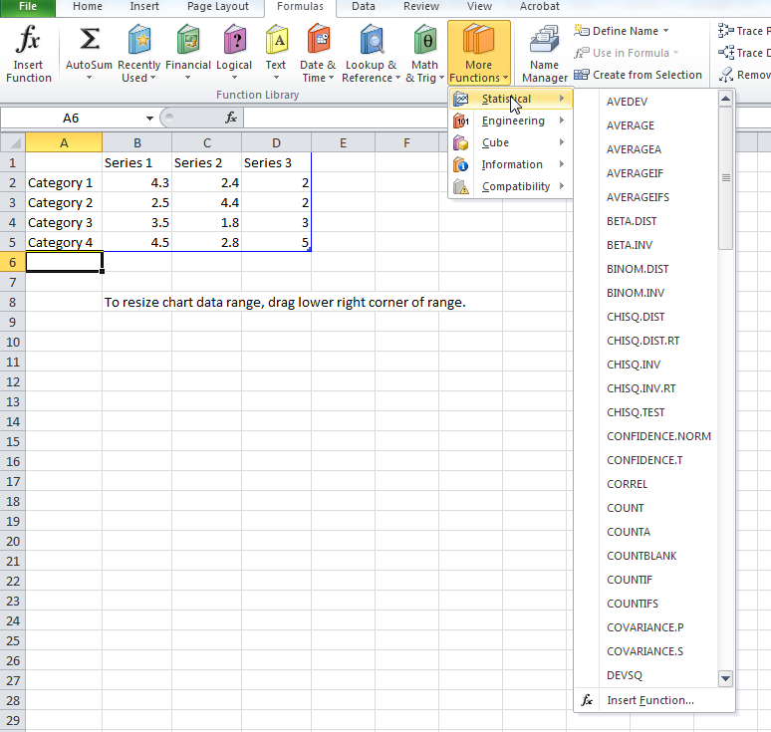
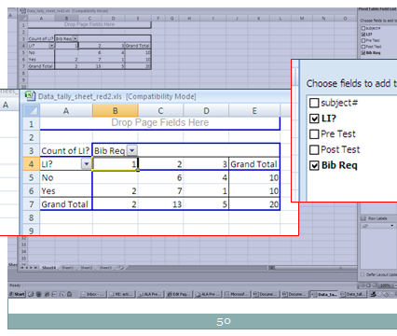
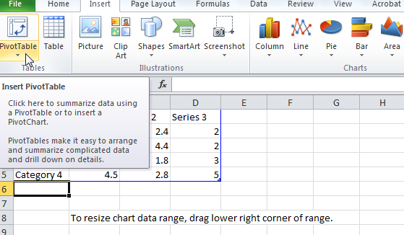
Notes:
You can run specific formulas in EXCEL which you can find under functions or more functions, statistical. One you’re probably already familiar with is Average, but you can also run STDEV or standard deviations from this menu. You can also create Pivot Tables, which are also known as cross tabs, and look similar to what April ran in many eyes. You would use that to find out if there is a correlation between data points, so, as in our example if more students who attended a library workshop met or exceeded a professor’s bibliographic requirements.
If you are using a PC, you can download the analysis toolpak add in for EXCEL. This will enable you to select a set of data and ask EXCEL to run standard statistical tests on it.
However, you will need a good guide so you can understand what kind of data you have, and what tests to run and how to run them. We’ve recommended some in the bibliography.

Slide 23
Microsoft Excel

Slide 25
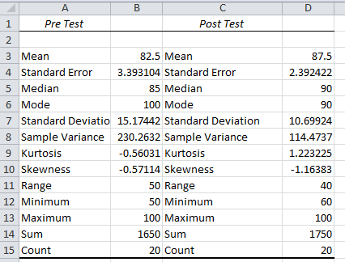
Notes:
Mean is the average – you can only use this if you have at least interval level data, median is the middle value when you place all of the values in order (ordinal) and the mode is the most frequently found value (nominal).
Skewness is how far off the range of values is from a perfect, balanced curve.
Standard deviation – standard amount of distance between interval scores, kurtosis, how peaked or flat the curve will be.

Slide 26
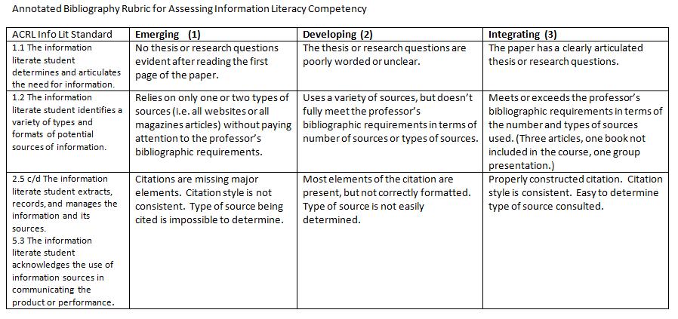
Rubrics
Notes:
Rubrics are used to analyze qualitative data. They list criteria and levels of achievement, then specify what the evaluator should see in order to rank or score what is being analyzed. They can be honed as the researcher analyzes data.
They are tested through use and should probably be tested with a second evaluator (interrater) and over time with the same evaluator (intrarater) : inter and intra-rater reliability,

Slide 27
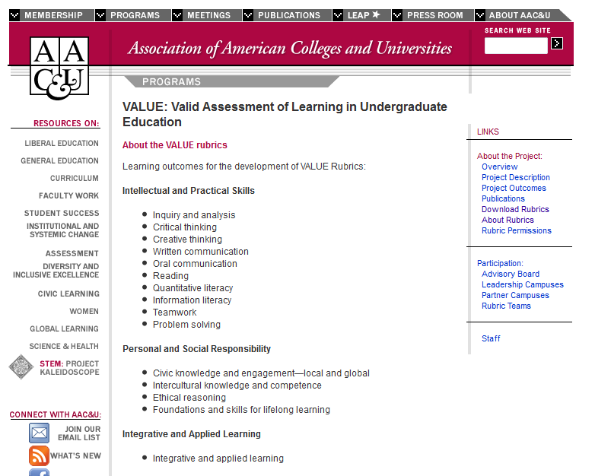
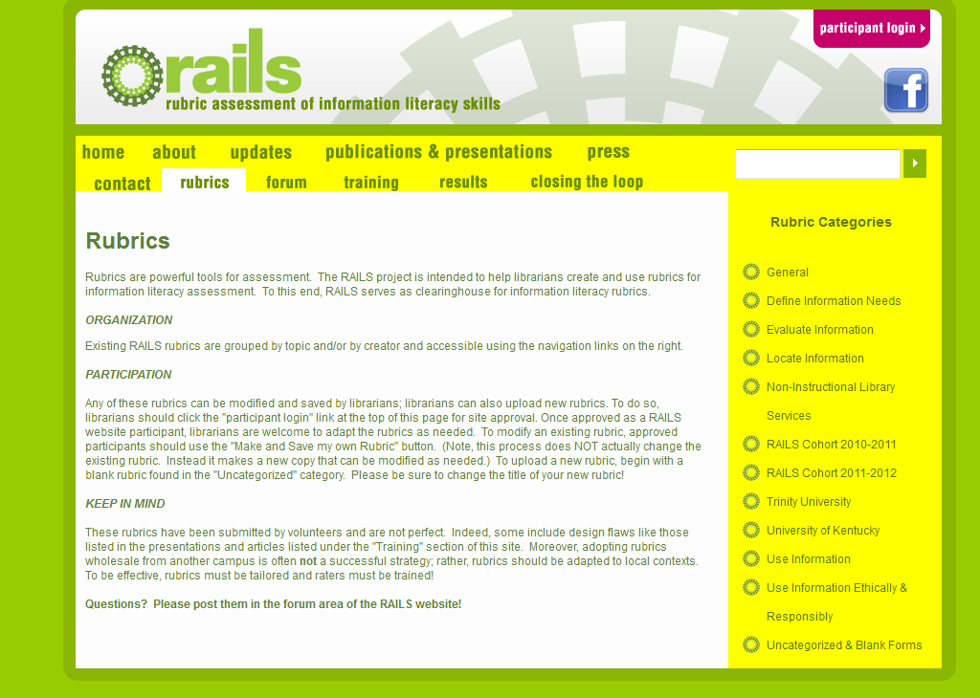
Notes:
some resources for finding rubrics already created AAU, RAILS etc.

Slide 28
Microsoft Word

Slide 29
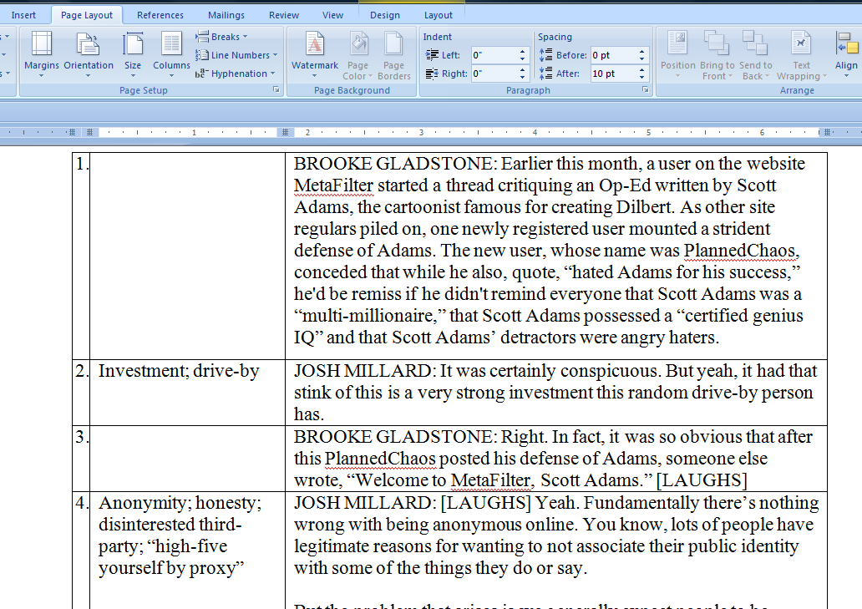

Slide 30
Linguistic Inquiry and Word Count (LIWC)
http://www.liwc.net/tryonline.php

Slide 32
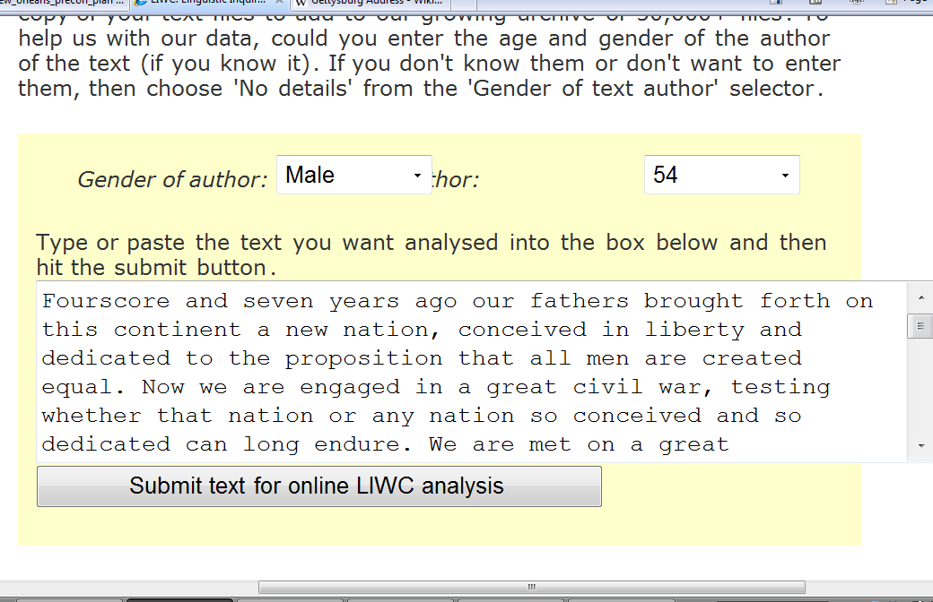

Slide 33
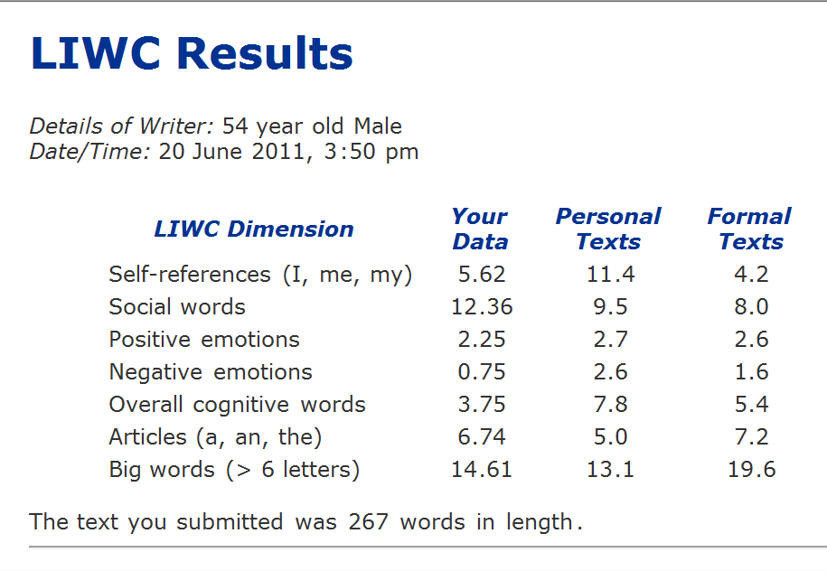

Slide 34
Text Stat
http://textstat.software.informer.com/

Slide 35
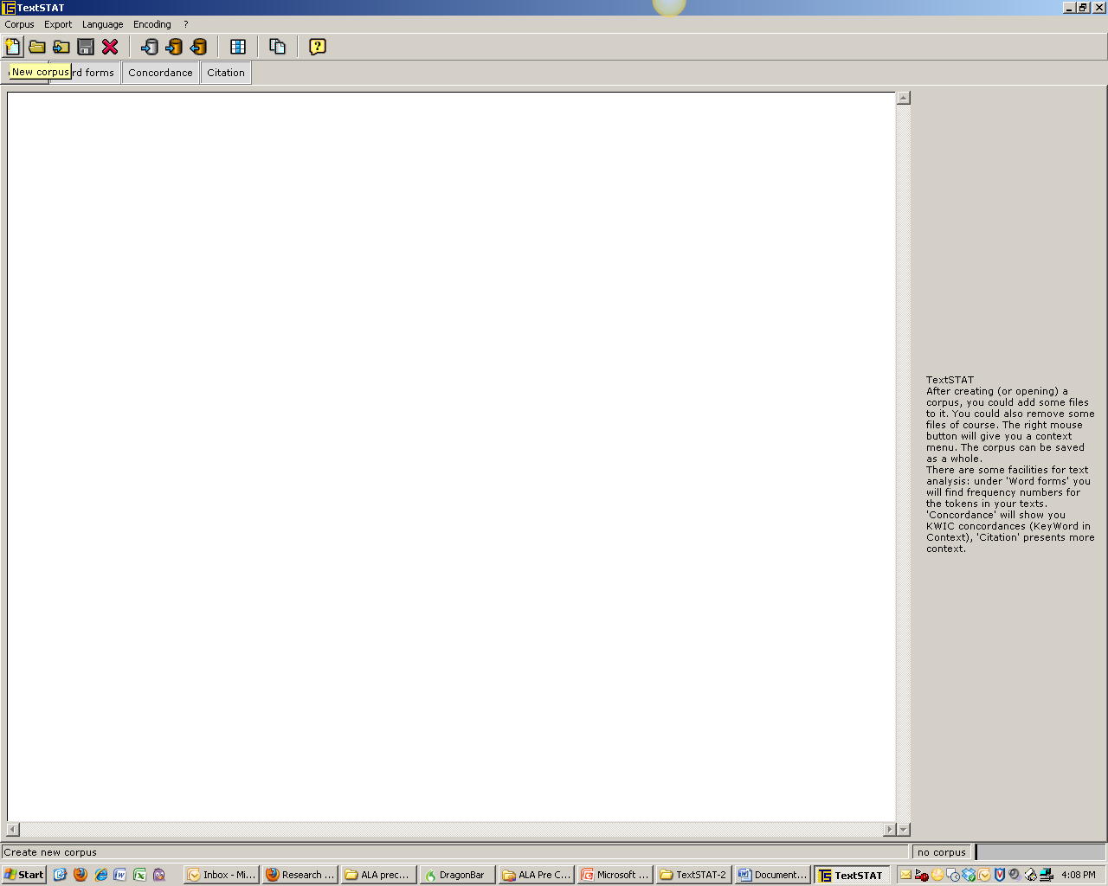

Slide 36
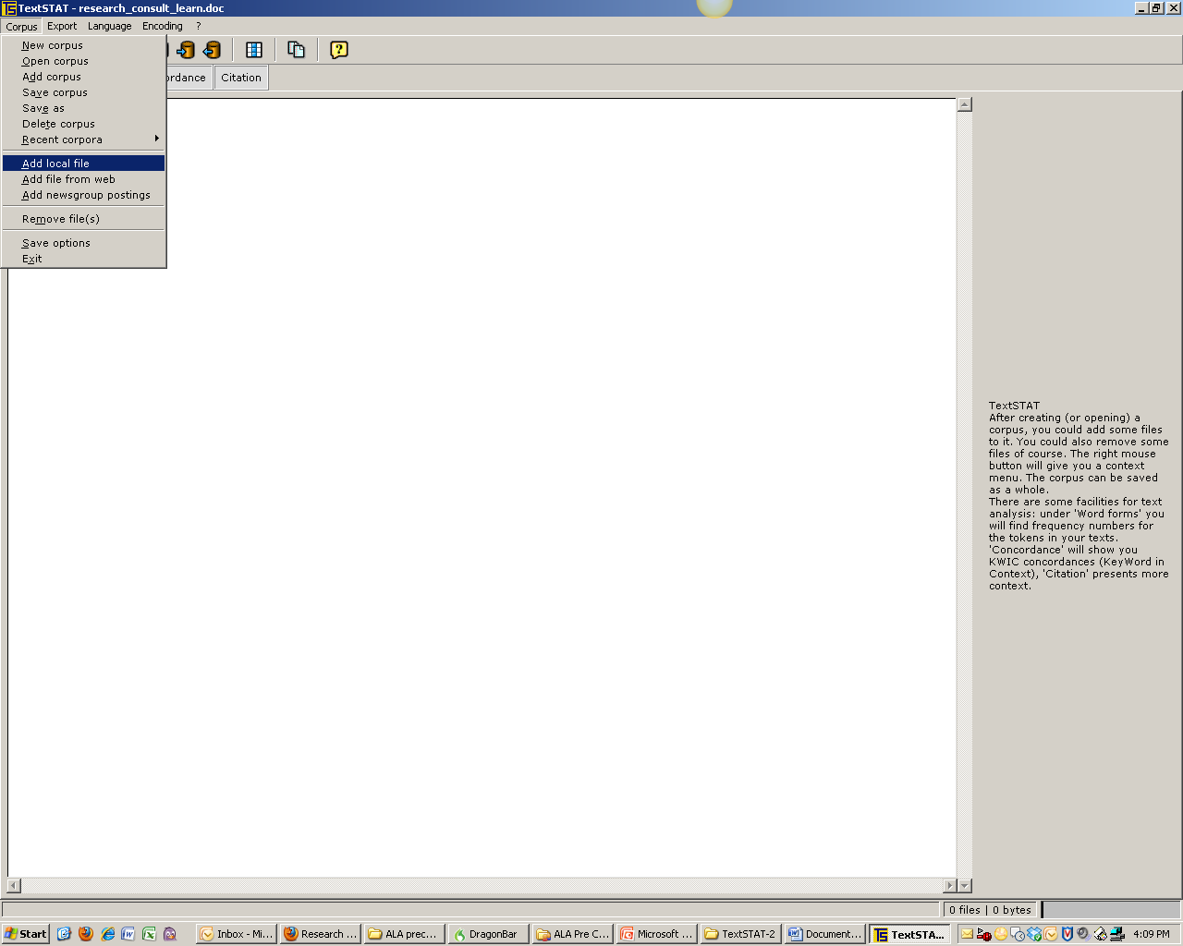

Slide 39
Reflect on Your Results
Evaluate the effects of the changes you made
What worked and what failed?
How well did it work or how much did it fail?
Why did some things work and some things fail?
Notes:
After analyzing the effects of your actions, look in the professional literature again to broaden your perspective as you answer the questions
If the consequences of your actions didn’t match up to your values and principles, why not?
Example:
Faculty did not change their assignments based on your professional development session, but two professors did meet with you later about their assignments and you helped them to make their instructions clearer.
Students’ surveys showed that understood the purpose of the sections of the articles they’re reading. Some students papers showed that students were incorporating sources and making connections but it wasn’t clear if this was a result of the instruction.

Slide 40
Reflect on Your Perspective
Here’s how your perspective could evolve
Preliminary Question: What’s the difference in the types of sources students are using when they come to one of my library orientations and when they don’t?
New Questions: What should the librarian’s role be in advising faculty and students about resource-based learning? What is a reasonable expectation for student learning following a single library orientation? When do students learn how to incorporate sources into their papers?
Notes:
Notice how the new questions may move your attention outside of your immediate sphere of influence. This is what makes Action Research a form of critical reflection, because it has the effect of revealing to practitioners their position in a larger system. Understanding the broader system can inspire some practitioners to advocacy or activism.

Slide 41
Action Research Cycle
Plan
Act
Reflect
Share
Notes:
Now we’re nearing the end of the cycle. You’ve investigated your problem, you’ve learned something new about and your work as a researcher. This is where you internalize what you’ve learned so if impacts your praxis – where the “lesson” is enacted but also internalized. EXAMPLE

Slide 42
Share
Who?
How?
Findings
Where?
Notes:
Action research is powerful because practitioners are the ones learning new things about their practice for their work. The only way that what you learn can change how we conduct our work is librarians is if you’re able to share your findings either formally or informally. This could simply mean talking to your critical friends or collaborators, speaking up at faculty or staff meetings, creating a blog post, the drinks and professional development among your colleagues. OR you can choose more formal avenues such as presenting a poster session at a conference or drafting a practitioner or scholarly article.

Slide 43
Thank You
April Cunningham
acunningham@palomar.edu
Stephanie Rosenblatt
srosenblatt@cerritos.edu

